Slide 1
HOTEL APPLICATION

Slide 2
Developed by :
Funy Bintang Kheirunissa
Melinda Nur Puspita Dewi
Mutia Ayu Dianita

Slide 3
System Analysis :
The hotel application is an application which is help the receptionist to save the reservations data in Hotel database. It also can show the reservation data of the hotel reservation.

Slide 4
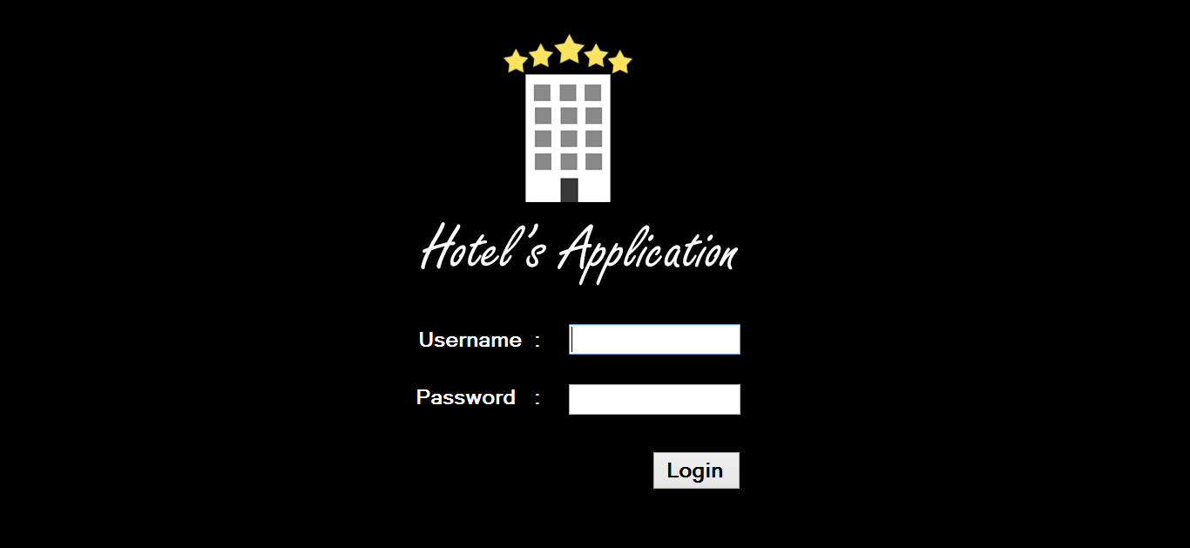
Interface design for Hotel Application
Login Panel of Hotel Application

Slide 5
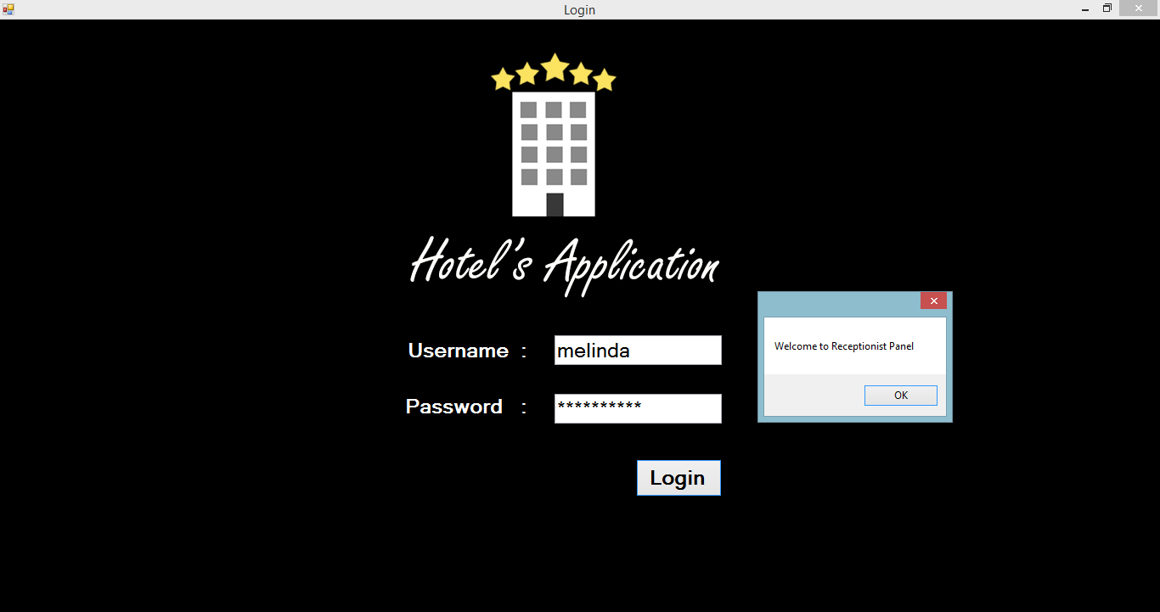
Admin login

Slide 6
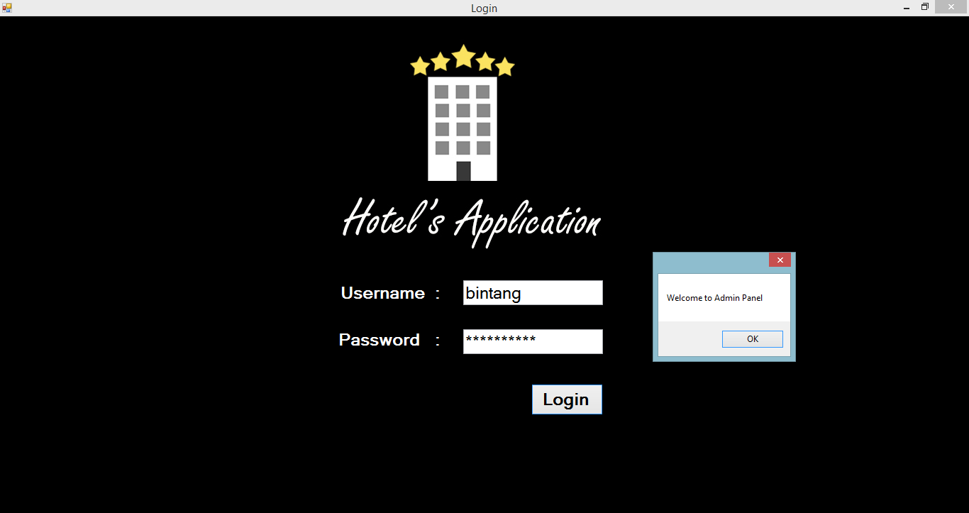
Admin Panel (1)

Slide 7
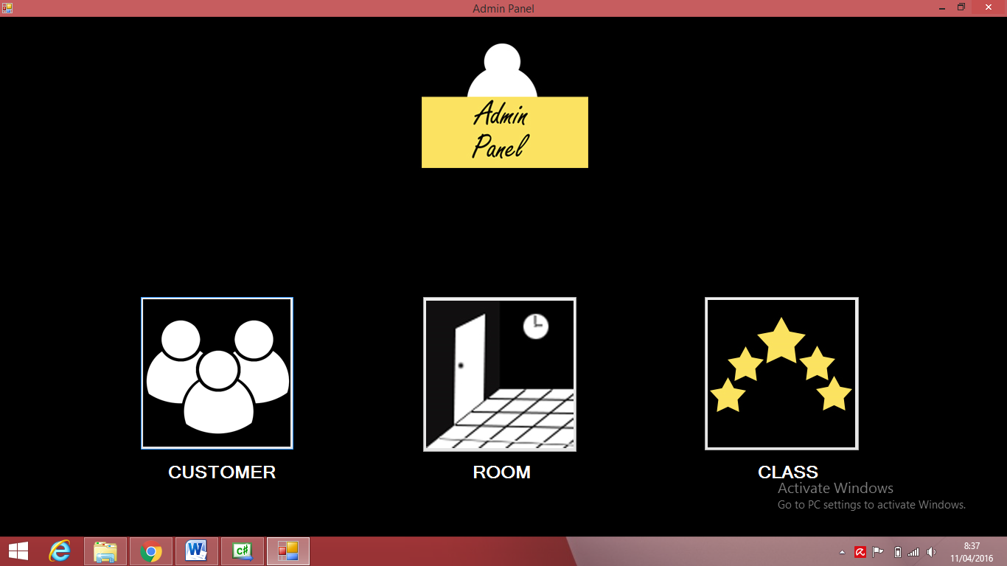
Admin panel

Slide 8
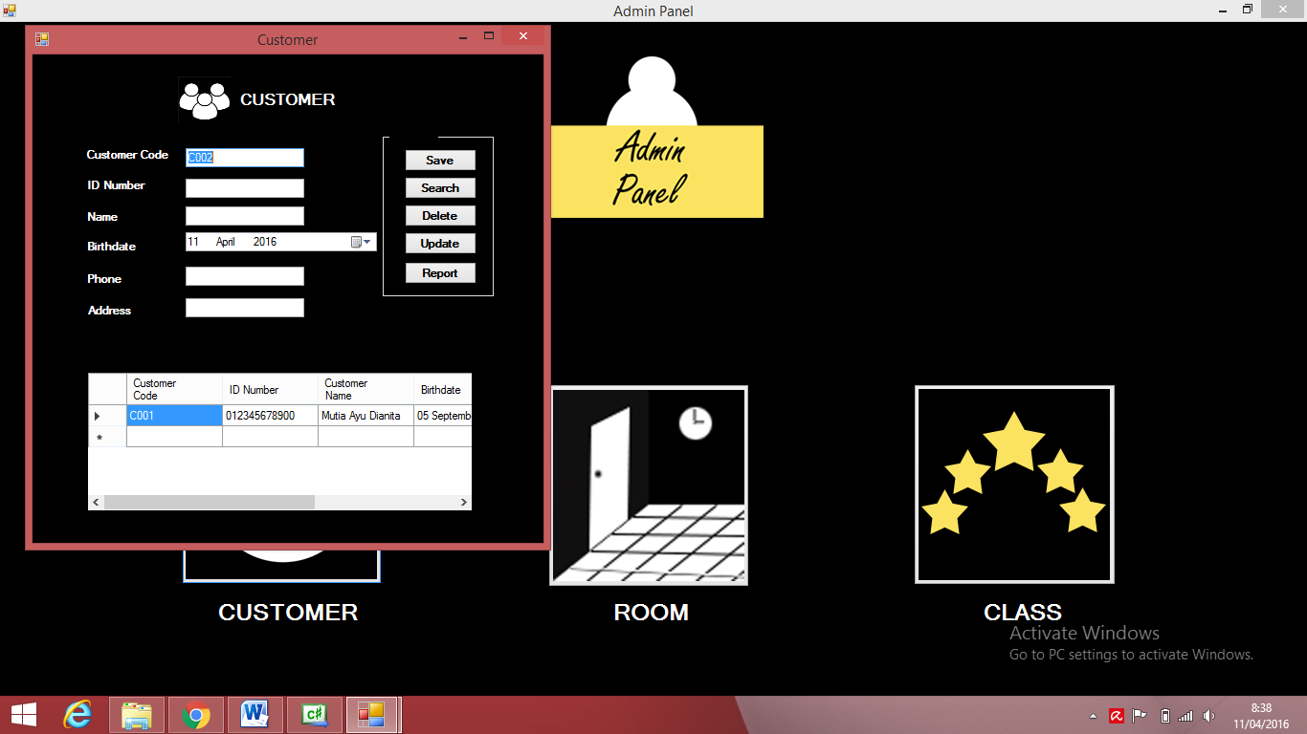
Customer Shown in Admin Panel

Slide 9
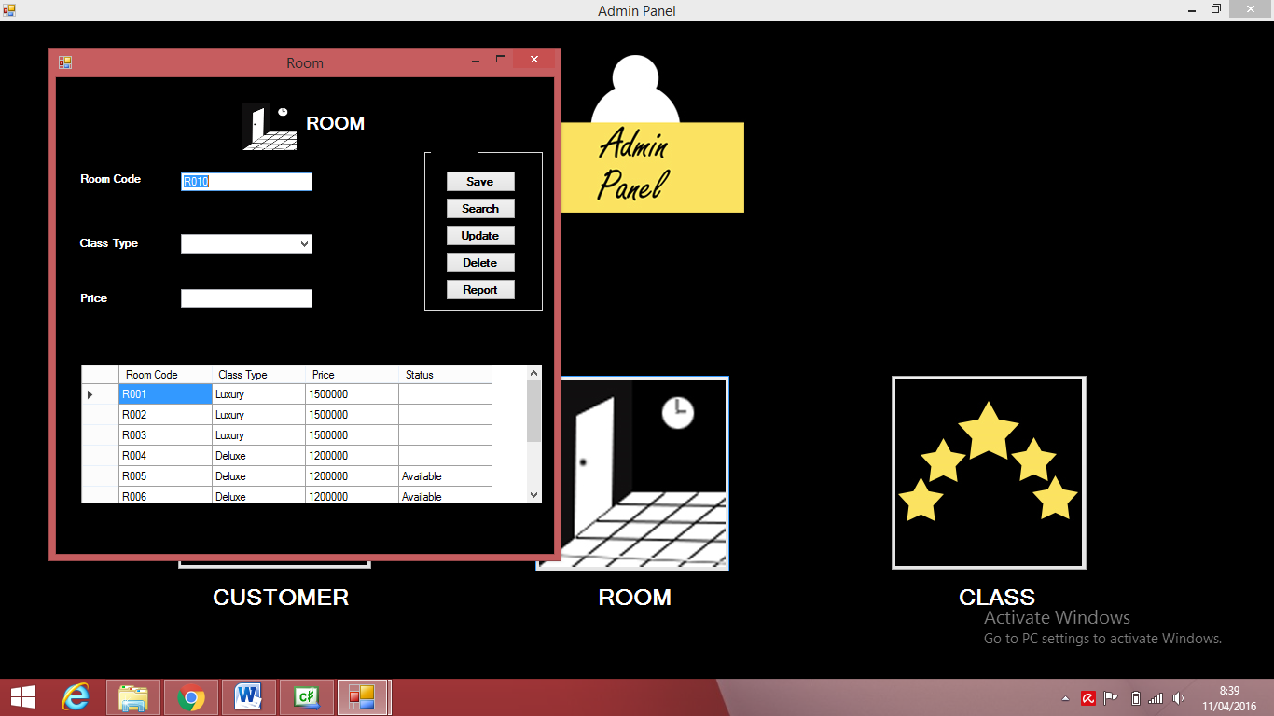
Room shown in Admin Panel

Slide 10
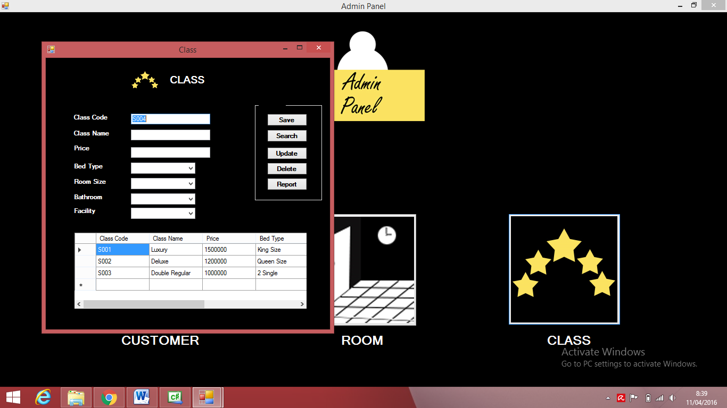
Class shown in Admin Panel

Slide 11
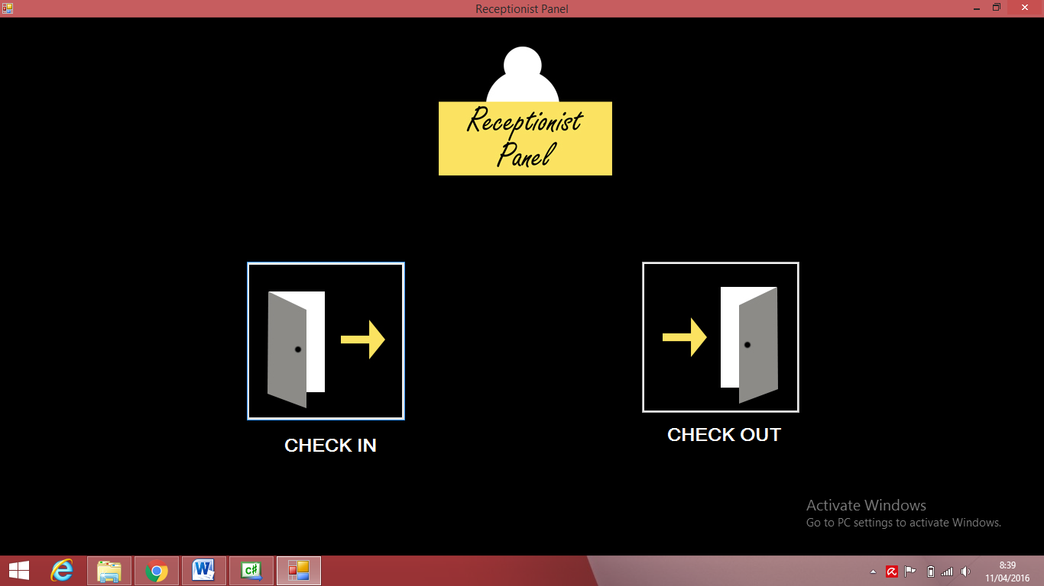
Receptionist Panel

Slide 12
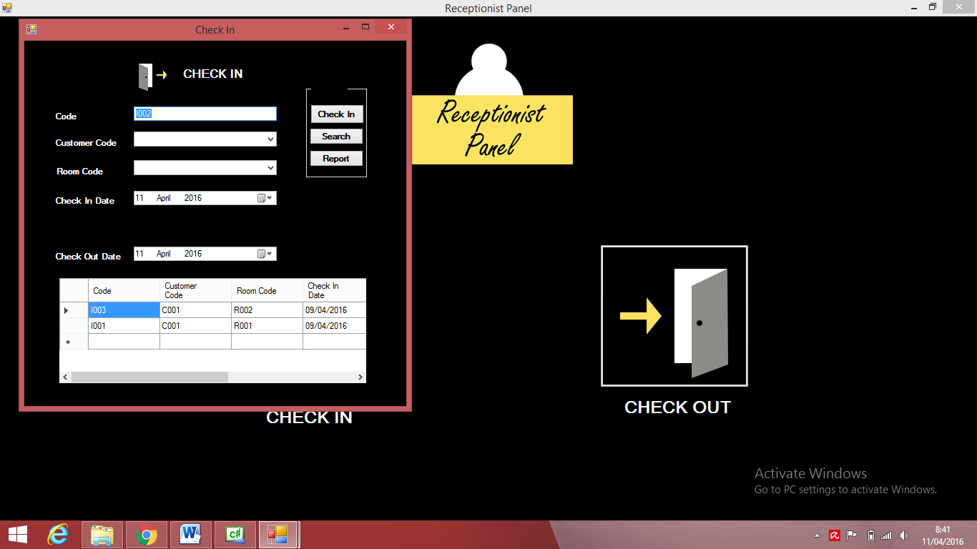
Check In

Slide 13
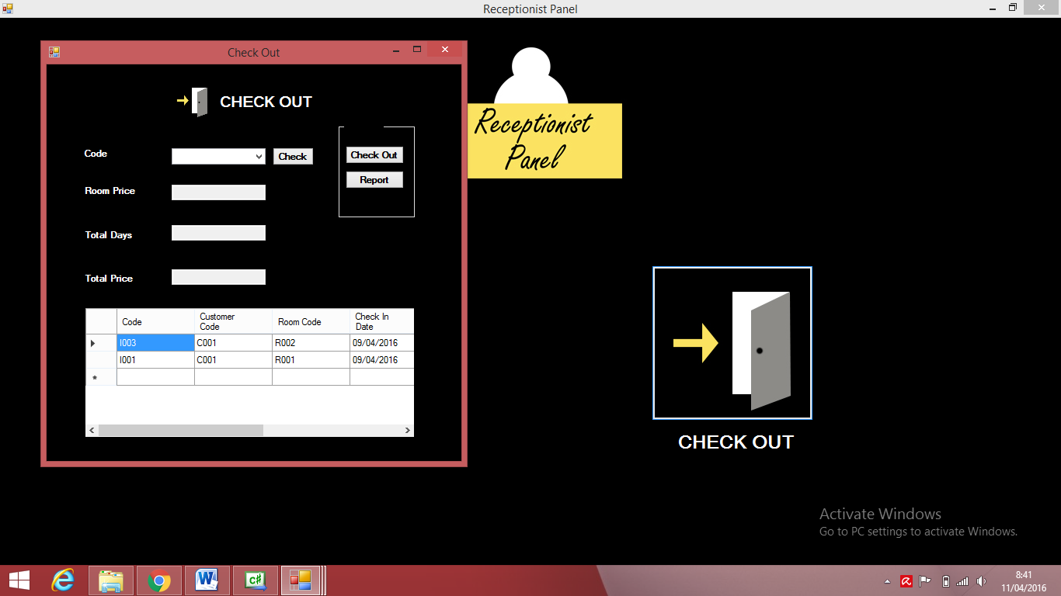
Check Out

Slide 14
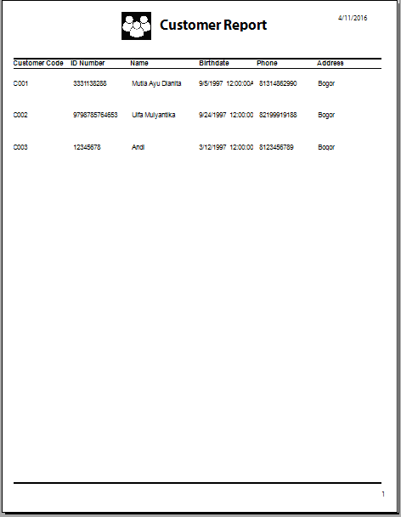
Customer Report

Slide 15
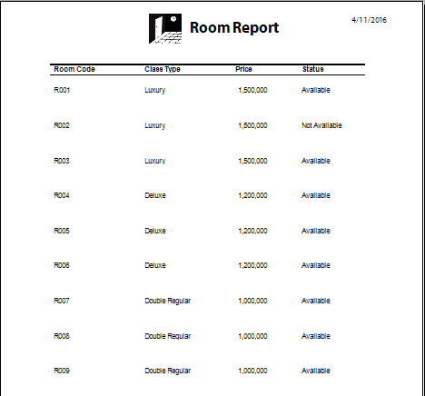
Room Report

Slide 16
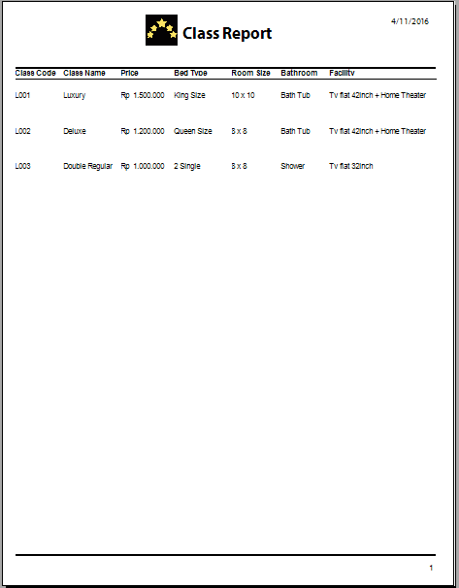
Class Report

Slide 17
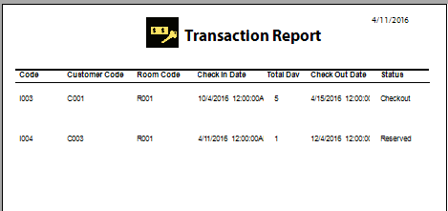
Transaction

Slide 18

Thank You

